Slide 1

Farmer’s Techie - IOTC & ML
Hema Likhitha Adapa
Varsha Pravallika Valavala
Kaushik Ram Koteshwar Venna
Sumanth Kumar Sivadi
Sri Vasavi Peravarapu

Slide 2
Introduction
The current trending technologies are Cloud, Machine Learning, Internet of Things.
There are many things we can solve using these current technologies. We thought of a way to solve of the problem that we mostly see using these technologies.
Even in this technological world there are still few things which are following the traditional methods, one those sectors is Agriculture sector. There is lot of upgrade in the agriculture techniques but still we can implement many more things.

Slide 3
Motivation
Water is main resource for any type of crop. Crop with the right amount of water gives good yield. Supplying correct amount of water to crop is crucial. Supplying proper water can’t be possible all the time by humans.
Smart irrigation is a one-time investment and further reduces the cost.
Over irrigation can lead to problems such as erosion, nutrient leaching and decreases soil fertility.
Use of technologies provides farmer with access to detailed data about their fields.
Hema Likhitha

Slide 4
Problem Definition
In many cases, Farmer’s themselves should get into the field to perform irrigation but there are some situations where they themselves can’t do the things manually.
Such as checking soil moisture level, temperature, humidity.
This process is time consuming and there can be many human errors.
Checking these levels and maintaining the level at regular interval of times cannot be possible all the time.
There are some techniques where irrigation starts as soon as the soil moisture drops but, in that case when there is sudden increment in moisture level through external factor then crop maybe damaged.

Slide 5
Proposed Solution
Our Proposed solution to develop the automated irrigation system. Farmer without actually getting into the farm and can access the information through mobile device.
We would like to implement this using Machine Learning and Internet of Things(IOT).
We calculate the moisture in the soil in timely basis
If the moisture level is less than the cutoff for certain time we take the automatic necessary irrigation action. We do this through the Formal Verification methods.
Every time there is a requirement of irrigation it is notified to farmer by storing the data in the cloud.

Slide 6
Experiments
We would like to implement the smart irrigation technique using Internet of Things, Machine Learning, Cloud.
Some of the IOT devices like Soil moisture sensor, Node MCU, Wi-Fi module, Raspberry Pi and more.
Some Formal Machine Learning verification techniques like Decision tree etc.
We are using Cloud to store data based on daily, hourly, monthly and notify farmers regarding reports and irrigation.

Slide 7
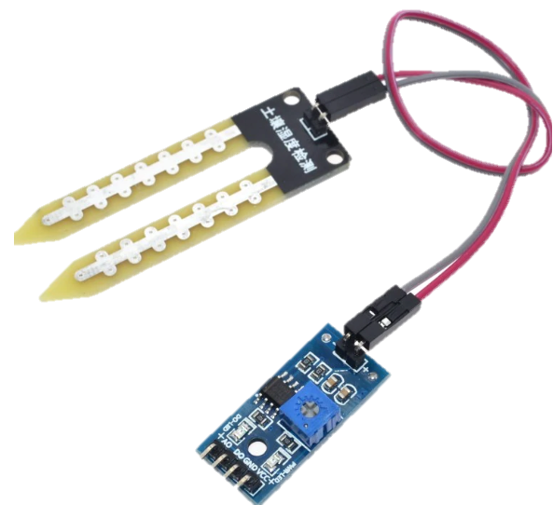
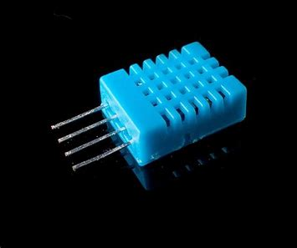
Experiments
Soil Moisture Sensor
Soil Moisture Sensor measure or estimate the amount of water in the soil. This sensor can be placed anywhere in the field to determine the soil moisture.
Humidity Sensor
Humidity sensor is a device that senses, measures and reports the relative humidity of air and measures the water vapor in the air.

Slide 8
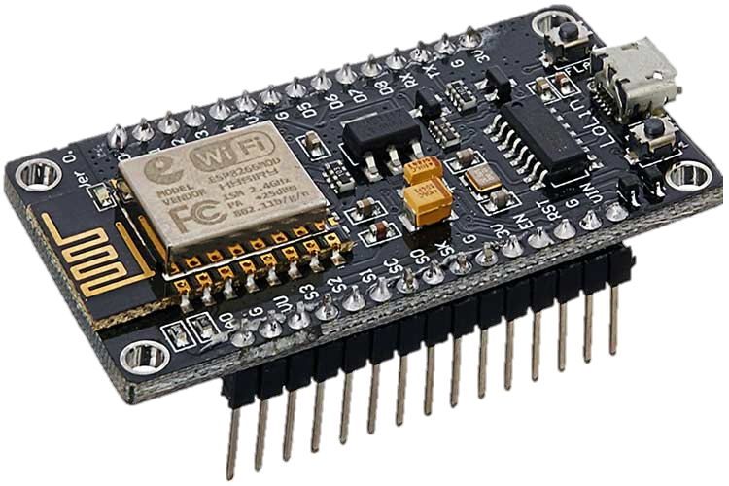
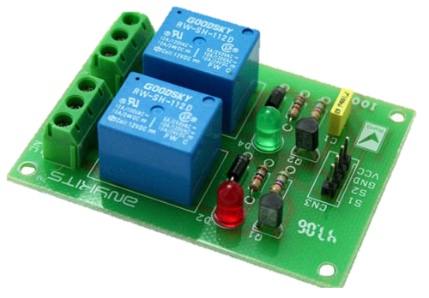
Experiments
Node MCU
Node MCU is a open-source firmware, hardware and software development environment project developed initially for Node MCU ESP8266 Wi-fi SoC chip based on LUA.
Relay Circuit board
Relay Circuit board is also known as Printed Circuit Board relay. It is an electronic device that controls the flow of electrical current in a circuit. It serves as a switch based on the control signal.

Slide 9
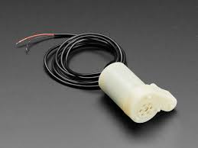
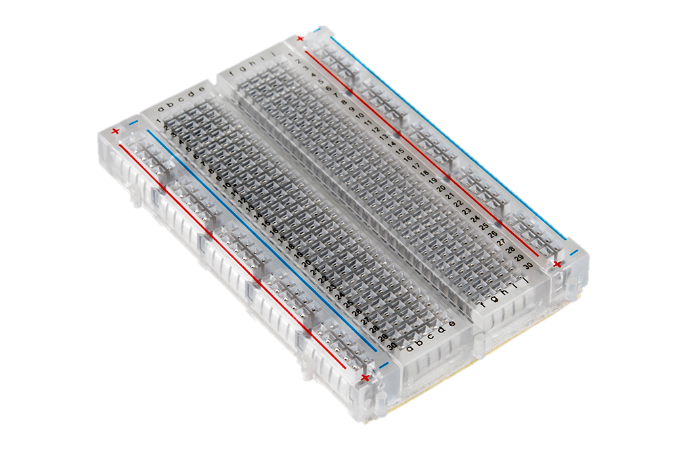
Experiments
Submersible water motor
These submersible water pumps are equipped with hermetically sealed motors. They allow the pumps to be fully submerged without the risk of electrical damage.
These pumps operate by using an electric motor to convert electrical energy into mechanical energy. They are designed to be fully submerged in the fluid that is being pumped.
Bread Board
Bread Board sometimes called as plugblock. It is used for building temporary circuits. It is useful to the person who wants to build a circuit to demonstrate its action, then to reuse the components in another circuit.

Slide 10
Experiments
Initially we connect the soil moisture sensors to the microcontroller, ensuring they’re properly calibrated.
Regularly reads the moisture level.
If the moisture level is below the threshold, wait and recheck after a specified delay.
If the moisture level remains low, activate the irrigation system. If it's above the threshold after rechecking, do not irrigate.
Set up cloud platform to receive data from the IoT device. Store historical moisture data and irrigation events.
Implement a system to alert the farmer via SMS, email, or a mobile app when irrigation is triggered or if there are any system issues.

Slide 11
Future Plan
In this semester and the following semester, we would like to implement, monitoring soil moisture level along with the temperature and humidity level.
In the following semester, we are going to implement Formal verification using ML methods.
We would also like to implement the Plant disease prediction using integrated camera.

Slide 12
Conclusion
In this technological world, everything has its own way of solving problems.
This IoT based smart irrigation project allows farmers to significantly upgrade agricultural practices.
Proper water management can lead to healthier crops and potentially higher yields.
It allows to maintain the proper soil moisture level and starts the irrigation with notifying the farmer regarding the irrigation and report.
This helps in improving the soil fertility, reduce cost to the farmers and for good yield.

Slide 13


Slide 14


